Slide 1
Chi-square
and Anova ++
17
Probability
and
Statistics
COMS10011
Dr. Anne Roudaut
csxar@bristol.ac.uk
https://github.com/coms10011

Slide 2
continuous independent variable
What type of data?
discrete independent variable
continuous dependent variable
discrete dependent variable
Continuous dependent variable
Discrete/categorical dependent variable
regressions
Logistic
regressions
normally distributed
skewed
2 grp
>2 grp
2 grp
>2 grp
2 grp
>2 grp
Non paired
paired
Non paired
paired
Non paired
paired
Non paired
paired
Counts >= 5 in >= 75% cells
Counts >= 5 in < 75% cells
T-test
ANOVA
Mann-Whitney Utest
Wilcoxon signed rank test
Kruskall-Wallis test
Chi-square test
Fisher’s exact test
Chi-square test
Paired-t-test
Friiedman test
McNemar’s test

Slide 3
until now, we did statistical test using means or medians but the assumptions for means have eliminated certain types of variables (e.g. gender)
mean not appropriate measure of central tendency for nominal (categorical type) data
Chi-square can do do!

Slide 4
there are two types of Chi-square tests:
goodness of fit test (for one variable only)
contingency table test (for two variables at a time)

Slide 5
goodness of fit

Slide 6
looks to see if a single variable fits some hypothesised probability distribution
e.g. in a population of students, there would be an equal number of students who like or dislike brussels sprouts
in fact we don’t even have to go 50/50, we may theorize that only 1/4 (25%) will like them (because they are disgusting!)

Slide 7
# of persons
like BP 11
Dislike BP 139
150 (total)

Slide 8
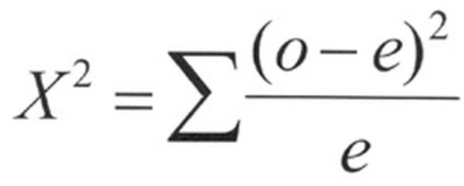
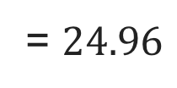
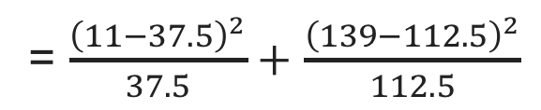
# of persons %expected # expected
like BP 11 25% 37.5 (25% of 150)
Dislike BP 139 75% 112.5 (75% of 150)
150 (total) 100% 150 (total)
observed cases
expected cases
= $\frac{{\left(11−37.5\right)}^{2}}{37.5}+$ $\frac{{\left(139−112.5\right)}^{2}}{112.5}$
= $24.96$

Slide 9
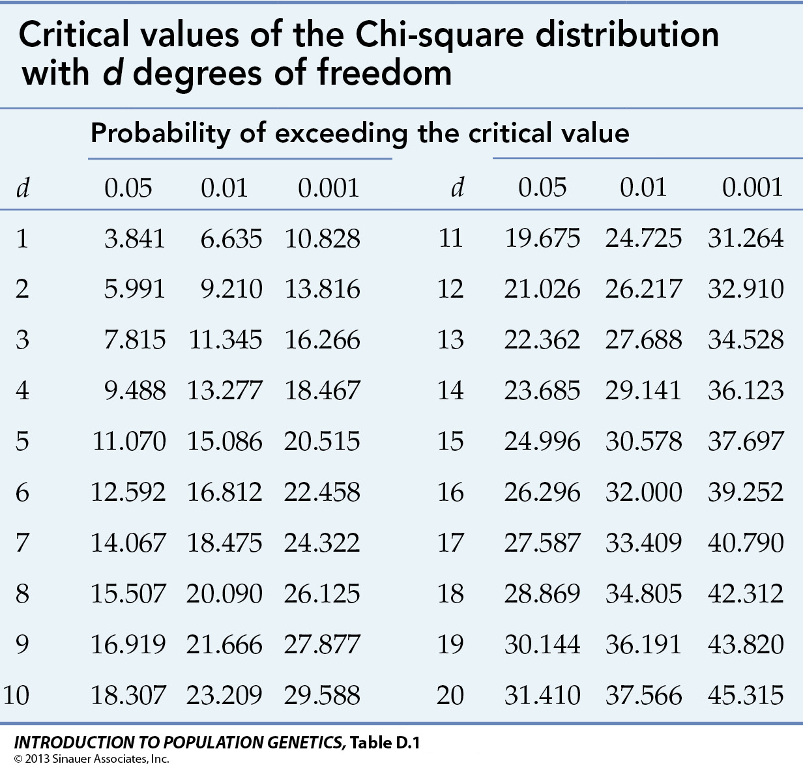
now, like with all the test we have seen, we look into a table, here the Chi-square table)
degree of freedom DF
= number of group - 1

Slide 10
24.96 > 3.841 so we reject the null hypothesis
our theory of 25% Brussel Sprout lovers does not hold

Slide 11
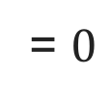
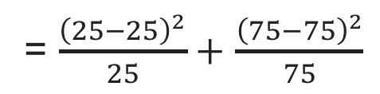
# of persons %expected # expected
like BP 25 25% 25 (25% of 100)
Dislike BP 75 75% 75 (75% of 100)
100 (total) 100% 100 (total)
observed cases
expected cases
= $\frac{{\left(25−25\right)}^{2}}{25}+$ $\frac{{\left(75−75\right)}^{2}}{75}$
= $0$
if data was perfect fit (pvalue would be = 1) … cannot reject null (thus cannot conclude)

Slide 12
let’s see if our theory holds with a raise of hand
who like Brussel sprout?
who dislike Brussel sprout?

Slide 13
R
table = c(11,139)
male female Sum
sport 26 3 29
family 24 22 46
Sum 50 25 75
chisq.test(tulip, p = c(1/4, 3/4))
Chi-squared test for given probabilities
data: tulip
X-squared = 24.969, df = 1, p-value = 5.826e-07

Slide 14
this example is fairly simple but Chi-square also work with more data, e.g. 30% prefer eating chicken for Christmas dinner, 50% prefer turkey, 10% prefer vegetarian option, 10% prefer other types of meat
… problem sheet 5 will be about that

Slide 15
contingency tables

Slide 16
public opinion surveys tend to show there is a relationship between gender and something, e.g. preference in sport car vs. family car (public opinion surveys are very stereotypical!)
so here we have two variables/groups: gender (female or male) and car preference (sport or family)
we do a Chi-square contingency table test to prove preference of car is related to or dependant upon gender
male female
sport 26 3
family 24 22

Slide 17

but we don’t have ”expected value” here so we first need to calculate them for each cell
where R = row, C= column, N = total,
for ith row and jth column

Slide 18
male female Sum
sport 26 3 29
family 24 22 46
Sum 50 25 75
1. we compute the sums in all direction
2. for each cell, multiplying that cells row and column totals and dividing by our total sample size
e.g. case (sport, male)= (29 * 50) / 75
e.g. case (family, male= (46 * 50) / 75
…

Slide 19
Obs. male female
sport 26 3
family 24 22
Exp. male female
sport 19.3 0.9
family 30.6 15.3
4. use same Chi-square formula than before
5. Calculate degree of freedom as DF =(number of rows−1)∗(number of columns−1) (here = 1)
6. Use the Chi-square table to conclude!
Notes:
pchisq(0.43, df=2, lower.tail = FALSE)

Slide 20
R
table = matrix(c(26, 24, 3, 22), ncol=2)
colnames(table) = c('male', 'female')
rownames(table) = c('sport','family’)
addmargins(table)
male female Sum
sport 26 3 29
family 24 22 46
Sum 50 25 75
chisq.test(table,correct=FALSE) #must use correct=FALSE for a 2 by 2 table otherwise = TRUE
Pearson's Chi-squared test
data: table
X-squared = 11.244, df = 1, p-value = 0.0007986

Slide 21
we reject the null and conclude that car type preference is dependant of gender

Slide 22
Chi-square contingency test::
if you have two categorical variables, and you’d like to determine whether the variables are independent
(sometimes called a test of independence)
H0: the 2 categorical variables are independent (no relationship between the variables)

Slide 23
in R

Slide 24
2 grp
>2 grp
Non paired
paired
Counts >= 5 in >= 75% cells
Counts >= 5 in < 75% cells
Chi-square test
Fisher’s exact test
Chi-square test
McNemar’s test

Slide 25
R
> library(MASS) # load the MASS package > tbl = table(survey$Smoke, survey$Exer)
> tbl # the contingency table Freq None Some Heavy 7 1 3 Never 87 18 84 Occas 12 3 4 Regul 9 1 7
>chisq.test(tbl) # or fisher.test(tbl) if Counts >= 5 in < 75% cells
Pearson’s Chi-squared test data: table(survey$Smoke, survey$Exer) X-squared = 5.4885, df = 6, p-value = 0.4828
Notes:
head(cars) # cars is a table that already comes with R and contain 50 observations of speed and distance in two rows
scatter.smooth(x=cars$speed, y=cars$dist, main="Dist ~ Speed") # scatterplot
linearMod <- lm(dist ~ speed, data=cars) # build linear regression model on full data
summary(linearMod) # summary(linearMod)$r.squared
abline(linearMod, col="blue")

Slide 26
R
# mcnemar example on presidential Approval Ratings: Approval of the President's performance in office in two surveys, one month apart, for a random sample of 1600 voting-age Americans.
Performance <- matrix(c(794, 86, 150, 570), nrow = 2, dimnames = list("1st Survey" = c("Approve", "Disapprove"), "2nd Survey" = c("Approve", "Disapprove")))
Performance
2nd Survey
1st Survey Approve Disapprove
Approve 794 150
Disapprove 86 570
mcnemar.test(Performance)
Notes:
head(cars) # cars is a table that already comes with R and contain 50 observations of speed and distance in two rows
scatter.smooth(x=cars$speed, y=cars$dist, main="Dist ~ Speed") # scatterplot
linearMod <- lm(dist ~ speed, data=cars) # build linear regression model on full data
summary(linearMod) # summary(linearMod)$r.squared
abline(linearMod, col="blue")

Slide 27
that was easy and we are done with Chi-square!
now I would like to briefly come back to ANOVA for a bit (oh not again!)

Slide 28
statistic tests on multiple variables

Slide 29
until now, we did statistical test on one independent variable (with multiple conditions or groups) and one dependant variable
e.g. effect of chocolate, baseline, punishment (IV) on memorization score (DV)
now it is possible to do tests for multiple IVs and multiple DVs (e.g. with CHI-square contingency table we look at two IVs).

Slide 30
however doing so decrease the power of your experiment (because you run more tests)
so it only works with powerful tests based on ANOVA (i.e. continuous variable and assumption of normality and homogeneity assumed)
e.g. two-ways ANOVA, MANOVA, ANVOVA

Slide 31
discrete IV
continuous DV
one-way ANOVA::
compare the effect of one discrete independent variables, having 2 or more levels on one dependant variable
e.g. effect of alcohol consumption (none, 2-pints, 4-pints) on attractiveness ratings

Slide 32
discrete IV
continuous DV
discrete IV
two-way ANOVA::
compare the effect of two discrete independent variables, each of them having 2 or more levels on one dependant variable
e.g. effect of gender (female, male) and alcohol consumption (none, 2-pints, 4-pints) on attractiveness ratings

Slide 33
continuous DV
discrete IV
continuous DV
one-way MANOVA::
(multivariate analysis of variance) compare the effect of one independent variable, having 2 or more levels on two dependant variables
e.g. effect of different memorization enhancing drugs (placebo, drug A, drug B) on memorization skills and emotional ratings (to find the sweet spot for a drug that enhance skills without depressing people!)

Slide 34
discrete IV
continuous DV
continuous covariate
one-way ANCOVA::
(analysis of covariance) compare the effect of one independent variable, having 2 or more levels and one continuous covariate on one dependant variable
e.g. effect of phone sizes (iphone 4, iphone 5, iphone 6, iphone 7) on the amplitude of phone movements made when texting given the measure of the participants hand width (covariate)

Slide 35
discrete IV
continuous DV
continuous covariate
continuous DV
one-way MANCOVA::
(multivariate analysis of covariance) compare the effect of one independent variable, having 2 or more levels and one continuous covariate on two dependant variable
… you can even two a two-way MANCOVA (but your experience might not have much statistical power because there are too many tests to perform)

Slide 36
although these tests exist, my advice would be to keep the experimental design as simple as possible as you can, analysis will be easier and more powerful
… we will look at power next time with a guest lecturer: Luluah Al-Barrack

Slide 37
two ways ANOVA practically

Slide 38
R
# two-ways anova in R (I added a gender column in our chocolate vs. reward vs. punishment file)
library(ez)
dat = read.csv("HCI2018resultsTwoWays.csv", header = TRUE)
ezANOVA(dat,id,between=.(group,gender),dv=score)
Effect DFn DFd F p p<.05 ges
1 group 2 54 72.7776 4.709005e-16 * 0.72939818
2 gender 1 54 1.4112 2.400561e-01 0.02546778
3 group:gender 2 54 0.8064 4.517654e-01 0.02900052
# note here our two IV are between but we could have them both within or a combination of within and between we would write: ezANOVA(dat,id,within=group,between=gender,dv=score)
Like with one way with have the effect for each IV
As well as the interaction between both
Notes:
head(cars) # cars is a table that already comes with R and contain 50 observations of speed and distance in two rows
scatter.smooth(x=cars$speed, y=cars$dist, main="Dist ~ Speed") # scatterplot
linearMod <- lm(dist ~ speed, data=cars) # build linear regression model on full data
summary(linearMod) # summary(linearMod)$r.squared
abline(linearMod, col="blue")

Slide 39
we can write (only the significant one)
A two-way ANOVA showed a significant effect on IV1 (Fdf = F_value, p<0.05), on IV2 (Fdf = F_value, p<0.05) and on the interaction IV1 x IV2 (Fdf = F_value, p<0.05)
and then you can do your post-hoc comparison tests (although there are more to do!) and conclude

Slide 40
summary

Slide 41
continuous independent variable
What type of data?
discrete independent variable
continuous dependent variable
discrete dependent variable
Continuous dependent variable
Discrete/categorical dependent variable
regressions
Logistic
regressions
normally distributed
skewed
2 grp
>2 grp
by the end of this unit you will know what statistics tests to perform depending on your data and how
2 grp
>2 grp
2 grp
>2 grp
Non paired
paired
Non paired
paired
Non paired
paired
Non paired
paired
Counts >= 5 in >= 75% cells
Counts >= 5 in < 75% cells
T-test
ANOVA
Mann-Whitney Utest
Wilcoxon signed rank test
Kruskall-Wallis test
Chi-square test
Fisher’s exact test
Chi-square test
Paired-t-test
Friiedman test
McNemar’s test

Slide 42
unit menu
Linear regression
Hypothesis testing, comparing things
Experimental design a: T-test
Experimental design b: ANOVA
How T-test and ANOVA work
Non-parametric tests a, normality tests
Non-parametric tests b
Categorical data: Chi-square
Sample size, power and effect size (luluah)
Alternatives to p value testing
Questions before exam

Slide 43
take away
Be able to give the CHI-square formula (goodness of fit and contingency table)
Calculate a CHI-square by hand on an example with a single variable and conclude
Explain what is the different between goodness of fit and contingency table methods
Explain what is a two-way ANOVA, MANOVA and ANCOVA and be able to explain the differences between them

Slide 44
end

